Slide 1

CS212: Object Oriented Analysis and Design
C++ Programming
(Syntax and Semantics)

Slide 2
Recap of Lecture 1
Introduction to CS212
Logistics and evaluation pattern
Monday– 1 PM (Laboratory)
Tuesday, Wednesday, Thursday (9 AM)

Slide 3

Welcome to CS212
1
#include <iostream>
using namespace std;
// main() is where program execution begins.
int main() {
cout << “Welcome to CS212 !!"; // prints Hello World
return 0;
}
#include <iostream>
using namespace std;
// main() is where program execution begins.
int main() {
// prints Hello World
cout << “Welcome to CS212 !!";
return 0;
}

Slide 4
C++ Statements
Several type of statements
Selection (Conditional)
Iteration (Loops)
Jump
Label
Expression
Block
Try-Catch

Slide 5
Semicolons & Blocks in C++
In C++, the semicolon is a statement terminator.
x = y;
y = y+1;
add(x, y);
x = y; y = y+1; add(x, y);
Insertion operator
{
cout << "Hello World"; // prints Hello World
return 0;
}

Slide 6
C++ Identifiers and Keywords
Identifier is a name used to identify a user-defined item
Does not allow punctuation characters such as @, $, and % within identifiers.
Is CityName and cityName same?
Keywords are reserved set of words in C++

Slide 7
Comments in C++
C++ supports single-line and multi-line comments.
/* This is a comment */
/* C++ comments can also
* span multiple lines
*/
// I am a single line comment
/** C++ Supports
*// Nesting of comments
*/

Slide 8
C++ Data Types
Type | Purpose | Keyword
Boolean | Store flag values | bool
Character | A single character/ alphabet | char
Integer | Store a number (without decimal point) within a predefined range | int
Floating point | Store real numbers within a predefined range | float
Double floating point | Real numbers with wide range | Double

Slide 9
C++ Modifier Types
Modifier is used to alter the meaning of the base type
signed
unsigned
long
short

Slide 10
Signed and unsigned numbers
Unless otherwise specified, all integer data types are signed data types
They have values which can be positive or negative.
All sizes of integers and char type may be explicitly qualified as signed or unsigned.
Unsigned numbers are always non-negative numbers.

Slide 11
Type Qualifiers in C++
Qualifier | Meaning
const | Objects of type const cannot be changed by your program during execution
volatile | Variable's value may be changed in ways not explicitly specified by the program.
restrict | Restricted use of object of a class how it can be accessed. Only C99 adds a new type qualifier called restrict.

Slide 12
Variable Definition in C++
A variable definition specifies a data type
A list of one or more variables of that type as follows:
int i, j, k;
char c, ch;
float f, salary;
double d;
int d = 3, f = 5; // definition and initializing d and f.
byte z = 22; // definition and initializes z.
char x = 'x'; // the variable x has the value 'x'.

Slide 13
Declaration vs. Definition
// function declaration
int func();
int main() {
// function call
int i = func();
}
// function definition
int func() {
return 0;
}

Slide 14
Lvalues and Rvalues
lvalue : Expressions that refer to a memory location
rvalue : Refers to a data value that is stored at some address in memory.
int g = 20;
10 = 20;
10 = x;

Slide 15
Variable Scope in C++
2
A scope is a region of the program
Broadly speaking there are three places, where variables can be declared:
Variable Scope
Local
Formal Param.
Global

Slide 16
The static Storage Class
Instructs the compiler to keep a local variable in existence
During the life-time of the program
Instead of creating and destroying it each time it comes into and goes out of scope.
Causes variable's scope to be restricted to the file in which it is declared.

Slide 17
Extern storage class
3
Used to give a reference of a global variable
Visible to ALL the program files.
When to use?
Program has multiple files
A variable or function to be used in other files

Slide 18
typedef and Enumerated Types
Create a new name for an existing type
Each enumerator is a constant whose type is the enumeration.
typedef int feet;
feet distance;
enum enum-name { list of names } var-list;

Slide 19
Enum example
enum Animal
{
ANIMAL_CAT = -3,
ANIMAL_DOG,
ANIMAL_PIG,
ANIMAL_HORSE = 5,
ANIMAL_GIRAFFE = 5,
ANIMAL_CHICKEN
};
Best practice: Don’t assign specific values to your enumerators.
Rule: Don’t assign the same value to two enumerators in the same enumeration.

Slide 20
The #define Preprocessor
Preprocessor directives are lines included in the code of programs preceded by a hash sign (#)
These lines are not program statements but directives for the pre-processor.

Slide 21
Operators in C++
Arithmetic Operators
Relational Operators
Logical Operators
Bitwise Operators
Assignment Operators
Misc Operators

Slide 22
Arithmetic operators
4
Operator | Description | Example
+ | Adds two numbers | A+B
- | Subtracts second operand from first | A-B
* | Multiplies both the operands | A*B
/ | Divides numerator by denominator | A/B
% | Modulus operator (Integer only) | A%B
++ | Increment operator | A++ ➔ A= A+1
-- | Decrement operator | A-- ➔ A = A -1;
Returns the computed value

Slide 23
Relational Operator
5
Operator | Description | Example
== | Equality between the two operands | A == B
!= | In-equality between the two operands | A != B
> | Checks if left operand is greater than right operand | A > B
< | Checks if left operand is lesser than right operand | A < B
>= | Checks if left operand is greater than or equal to the right operand | A >= B
<= | Checks if left operand is less than or equal to the right operand | A <= B
Returns 1 if true, 0 if false

Slide 24
Logical Operator
6
Operator | Description | Example
&& | True if both the operands are true | A && B
|| | True if any one of the operand if true Also known as short-circuit operator | A || B
! | Checks if left operand is greater than right operand | ! (E)
E= statement
Returns 1 if true, 0 if false

Slide 25
Bitwise Operator
7
x | y | x & y | x | y | x ^ y
0 | 0 | 0 | 0 | 0
0 | 1 | 0 | 1 | 1
1 | 0 | 0 | 1 | 1
1 | 1 | 1 | 1 | 0
Standard Digital Logic Design Concepts
~ : Bitwise complement operator
<< : Left shift operator (Ex: A << B)
>> : Right shift operator (Ex: A >> B)

Slide 26
Assignment Operator
Operator | Description | Example
= | Simple assignment operator (Lvalue, Rvalue) | C = A (operator) B C = A
(operator) = | The left operand is operated by the right operand, and the result is stored in the left operand | A (operator)= B implies A = A (operator) B

Slide 27
Other operators
8, 9
sizeof()
Ternary operator
Example –
Expression ? If true : otherwise
.-> : Member operator
& : Address of
* : Dereferencing operator

Slide 28
Operators Precedence in C++
10
Determines the grouping of terms in an expression.
This affects how an expression is evaluated.
Certain operators have higher precedence than others
Associativity

Slide 29
C++ Selection Statements
11
If condition is true / false
C1
If condition is true / false
Take some action
C2
If condition is true / false
If condition is true / false
Take some action
If condition is true / false
If condition is true / false
C3
Take some action
…

Slide 30
C++ Iteration Statements
12
Execute a block of code several number of times: sequentially
For, While
Do-While
Conditional code
If condition is true
Condition
If condition is true
If condition is false

Slide 31
Loop control statements
Break
Continue
Infinite loop

Slide 32
Functions and subprograms
The Top-down design approach
Dividing the main problem into smaller tasks
A descriptive function name, e.g.
computeTaxes to compute the taxes for an employee
isPrime to check whether or not a number is a prime number
A parameter list
A returning value
The computeTaxes function may return with a double number representing the amount of taxes
The isPrime function may return with a Boolean value (true or false)

Slide 33
C++ Standard Functions
Shipped with a lot of functions which are known as standard functions
Grouped in different libraries which can be included e.g.
Math functions are declared in <math.h> library
Character-manipulation functions are declared in <ctype.h> library
Other popular ones: <iostream.h>, <stdlib.h>, <string.h>, …

Slide 34
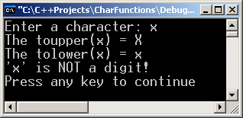
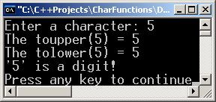
Example of Using Standard C++ Character Functions
#include <iostream.h> // input/output handling
#include <ctype.h> // character type functions
void main()
{
char ch;
cout << "Enter a character: ";
cin >> ch;
cout << "The toupper(" << ch << ") = " << (char) toupper(ch) << endl;
cout << "The tolower(" << ch << ") = " << (char) tolower(ch) << endl;
if (isdigit(ch))
cout << "'" << ch <<"' is a digit!\n";
else
cout << "'" << ch <<"' is NOT a digit!\n";
}
Explicit casting

Slide 35
How to define a C++ Function?
Generally speaking, we define a C++ function in two steps (preferably but not mandatory)
Step #1 – declare the function signature in either a header file (.h file) or before the main function of the program
Step #2 – Implement the function in either an implementation file (.cpp) or after the main function

Slide 36
What is The Syntactic Structure of a C++ Function?
A C++ function consists of two parts
The function header, and
The function body
The function header has the following syntax
<return value> <name> (<parameter list>)
The function body is simply a C++ code enclosed between { }

Slide 37
Example of User-defined C++ Function
double computeTax(double income)
{
if (income < 5000.0) return 0.0;
double taxes = 0.07 * (income-5000.0);
return taxes;
}

Slide 38
Example of User-defined C++ Function
Function header
double computeTax(double income)
{
if (income < 5000.0) return 0.0;
double taxes = 0.07 * (income-5000.0);
return taxes;
}

Slide 39
Example of User-defined C++ Function
Function header
Function body
double computeTax(double income)
{
if (income < 5000.0) return 0.0;
double taxes = 0.07 * (income-5000.0);
return taxes;
}

Slide 40
Function Signature
The function signature is actually similar to the function header except in two aspects:
The parameters’ names may not be specified in the function signature
The function signature must be ended by a semicolon
Example
double computeTaxes(double) ;
Semicolon ;
Unnamed Parameter

Slide 41
Inline Functions
Sometimes, we use the keyword inline to define user-defined functions
Inline functions are very small functions, generally, one or two lines of code
Inline functions are very fast functions compared to the functions declared without the inline keyword
Example
inline double degrees( double radian)
{
return radian * 180.0 / 3.1415;
}

Slide 42
Example #1
Write a function to test if a number is an odd number
inline bool odd (int x)
{
return (x % 2 == 1);
}

Slide 43
I. Using Global Variables
x
0
#include <iostream.h>
int x = 0;
void f1() { x++; }
void f2() { x+=4; f1(); }
void main()
{
f2();
cout << x << endl;
}

Slide 44
I. Using Global Variables
x
0
#include <iostream.h>
int x = 0;
void f1() { x++; }
void f2() { x+=4; f1(); }
void main()
{
f2();
cout << x << endl;
}
void main()
{
f2();
cout << x << endl ;
}
1

Slide 45
I. Using Global Variables
0
x
4
#include <iostream.h>
int x = 0;
void f1() { x++; }
void f2() { x+=4; f1(); }
void main()
{
f2();
cout << x << endl;
}
void f2()
{
x += 4;
f1();
}
2
void main()
{
f2();
cout << x << endl ;
}
1

Slide 46
I. Using Global Variables
4
x
5
#include <iostream.h>
int x = 0;
void f1() { x++; }
void f2() { x+=4; f1(); }
void main()
{
f2();
cout << x << endl;
}
void f1()
{
x++;
}
4
void f2()
{
x += 4;
f1();
}
3
void main()
{
f2();
cout << x << endl ;
}
1

Slide 47
I. Using Global Variables
4
x
5
#include <iostream.h>
int x = 0;
void f1() { x++; }
void f2() { x+=4; f1(); }
void main()
{
f2();
cout << x << endl;
}
void f1()
{
x++;
}
5
void f2()
{
x += 4;
f1();
}
3
void main()
{
f2();
cout << x << endl;
}
1

Slide 48
I. Using Global Variables
4
x
5
#include <iostream.h>
int x = 0;
void f1() { x++; }
void f2() { x+=4; f1(); }
void main()
{
f2();
cout << x << endl;
}
void f2()
{
x += 4;
f1();
}
6
void main()
{
f2();
cout << x << endl;
}
1

Slide 49
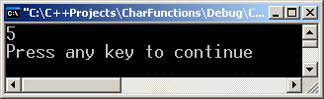
I. Using Global Variables
#include <iostream.h>
int x = 0;
void f1() { x++; }
void f2() { x+=4; f1(); }
void main()
{
f2();
cout << x << endl;
}
4
x
5
void main()
{
f2();
cout << x << endl;
}
7

Slide 50
I. Using Global Variables
#include <iostream.h>
int x = 0;
void f1() { x++; }
void f2() { x+=4; f1(); }
void main()
{
f2();
cout << x << endl;
}
4
x
5
void main()
{
f2();
cout << x << endl;
}
8

Slide 51
I. Using Global Variables
#include <iostream.h>
int x = 0;
void f1() { x++; }
void f2() { x+=4; f1(); }
void main()
{
f2();
cout << x << endl;
}

Slide 52
What Happens When We Use Inline Keyword?
#include <iostream.h>
int x = 0;
inline void f1() { x++; }
inline void f2() { x+=4; f1();}
void main()
{
f2();
cout << x << endl;
}

Slide 53
What Happens When We Use Inline Keyword?
#include <iostream.h>
int x = 0;
Inline void f1() { x++; }
Inline void f2() { x+=4; f1();}
void main()
{
f2();
cout << x << endl;
}
x
0
The inline keyword instructs the compiler to replace the function call with the function body!
void main()
{
x+=4;
x++;
cout << x << endl;
}
1

Slide 54
What Happens When We Use Inline Keyword?
#include <iostream.h>
int x = 0;
Inline void f1() { x++; }
Inline void f2() { x+=4; f1();}
void main()
{
f2();
cout << x << endl;
}
x
4
void main()
{
x+=4;
x++;
cout << x << endl;
}
2

Slide 55
What Happens When We Use Inline Keyword?
#include <iostream.h>
int x = 0;
Inline void f1() { x++; }
Inline void f2() { x+=4; f1();}
void main()
{
f2();
cout << x << endl;
}
x
5
void main()
{
x+=4;
x++;
cout << x << endl;
}
3

Slide 56
What Happens When We Use Inline Keyword?
#include <iostream.h>
int x = 0;
Inline void f1() { x++; }
Inline void f2() { x+=4; f1();}
void main()
{
f2();
cout << x << endl;
}
x
5
void main()
{
x+=4;
x++;
cout << x << endl;
}
4

Slide 57
What Happens When We Use Inline Keyword?
#include <iostream.h>
int x = 0;
Inline void f1() { x++; }
Inline void f2() { x+=4; f1();}
void main()
{
f2();
cout << x << endl;
}

Slide 58
Reference Parameters
Changes in the value parameters don’t affect the original function arguments
Change the values of the original function arguments
Return with more than one value from the function
It is just another name to the original argument variable
We define a reference parameter by adding the & in front of the parameter name, e.g.
double update (double & x);

Slide 59
Example of Reference Parameters
#include <iostream.h>
void fun(int &y)
{
cout << y << endl;
y=y+5;
}
void main()
{
int x = 4; // Local variable
fun(x);
cout << x << endl;
}
void main()
{
int x = 4;
fun(x);
cout << x << endl;
}
1
x
?
x
4

Slide 60
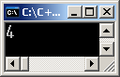
Example of Reference Parameters
#include <iostream.h>
void fun(int &y)
{
cout << y << endl;
y=y+5;
}
void main()
{
int x = 4; // Local variable
fun(x);
cout << x << endl;
}
void fun ( int & y )
{
cout<<y<<endl;
y=y+5;
}
3
void main()
{
int x = 4;
fun(x);
cout << x << endl;
}
x
?
x
4
2

Slide 61
Example of Reference Parameters
#include <iostream.h>
void fun(int &y)
{
cout << y << endl;
y=y+5;
}
void main()
{
int x = 4; // Local variable
fun(x);
cout << x << endl;
}
void fun( int & y )
{
cout<<y<<endl;
y=y+5;
}
4
9
void main()
{
int x = 4;
fun(x);
cout << x << endl;
}
x
?
x
4
2

Slide 62
Example of Reference Parameters
#include <iostream.h>
void fun(int &y)
{
cout << y << endl;
y=y+5;
}
void main()
{
int x = 4; // Local variable
fun(x);
cout << x << endl;
}
void fun( int & y )
{
cout<<y<<endl;
y=y+5;
}
5
void main()
{
int x = 4;
fun(x);
cout << x << endl;
}
x
?
x
9
2

Slide 63
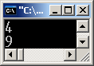
Example of Reference Parameters
#include <iostream.h>
void fun(int &y)
{
cout << y << endl;
y=y+5;
}
void main()
{
int x = 4; // Local variable
fun(x);
cout << x << endl;
}
void main()
{
int x = 4;
fun(x);
cout << x << endl;
}
x
?
x
9
6

Slide 64
Example of Reference Parameters
#include <iostream.h>
void fun(int &y)
{
cout << y << endl;
y=y+5;
}
void main()
{
int x = 4; // Local variable
fun(x);
cout << x << endl;
}
void main()
{
int x = 4;
fun(x);
cout << x << endl;
}
?
x
9
7

Slide 65
Recursion
A task that is defined in terms of itself.
A function that calls itself.
With each invocation, the problem is reduced to a smaller task (reducing case)
Until the task arrives at some terminal case.

Slide 66
Recursive Functions
A recursive function has two parts:
The terminal/base case.
- a stopping condition
The reducing case/recursive step
an expression of the computation or definition in terms of itself

Slide 67
General algorithm for recursion
if (terminal_condition)
terminal_case
else
reducing_case
if (!terminal_condition)
reducing_case

Slide 68
The Factorial Function
n! = n * (n-1) * (n -2) * … * 2 * 1
5! = 5 * 4 * 3 * 2 * 1
The same function can be defined recursively as fallows:
0! = 1 – terminal case
n! = n * (n - 1)! - the reducing case

Slide 69
The Factorial Function
5! = 5 * 4!
4! = 4 * 3!
3! = 3 * 2!
2! = 2 * 1!
1! = 1! * 0!
0! = 1 Terminal Case
Reducing Case

Slide 70
Factorial Function in C++
13
int fact(int n)
{ if (n < 2) // terminal case return 1; else
return (n * fact(n - 1)); // recursive step
}

Slide 71
Structures
A Structure is a collection of related data items, possibly of different types.
A structure type in C++ is called struct.
A struct is heterogeneous in that it can be composed of data of different types.
In contrast, array is homogeneous since it can contain only data of the same type.

Slide 72
Structures
Structures hold data that belong together.
Examples:
Student record: student id, name, major, gender, start year, …
Bank account: account number, name, currency, balance, …
Address book: name, address, telephone number, …
In database applications, structures are called records.

Slide 73
Structures
Individual components of a struct type are called members (or fields).
Members can be of different types (simple, array or struct).
A struct is named as a whole while individual members are named using field identifiers.
Complex data structures can be formed by defining arrays of structs.

Slide 74
struct basics
Definition of a structure:
struct <struct-type>{
<type> <identifier_list>;
<type> <identifier_list>;
...
} ;
Example:
struct Date {
int day;
int month;
int year;
} ;
Each identifier defines a member of the structure.
The “Date” structure
has 3 members,
day, month & year.

Slide 75
struct examples
14
Example:
struct StudentInfo{
int Id;
int age;
char Gender;
double CGA;
};
Example:
struct StudentGrade{
char Name[15];
char Course[9];
int Lab[5];
int Homework[3];
int Exam[2];
};
The “StudentInfo” structure has 4 members
of different types.
The “StudentGrade” structure has 5 members of
different array types.

Slide 76
Arrays of structures
An ordinary array: One type of data
An array of structs: Multiple types of data in each array element.
0 1 2 … 98 99
0 1 2 … 98 99

Slide 77

Class: Capabilities and attributes

Slide 78
Step 1: Class Identification
Use the problem statement or requirements document to find all of the nouns and verbs in the problem statement.
The nouns represent the object/classes in the system;
The verbs may show what their responsibilities are.

Slide 79
Step 1: Class identification
Part of Speech | Model Component | Example
Proper noun | Instance | Ravindran
Common noun | Class field | Offer
Doing verb | Operation | Create, submit, select
Being verb | Inheritance | Is a kind of, is one of either
Having verb | Aggregation | Has, Consists of, includes
Modal verb | Constraints | Must, may, should, ought
Adjective | Attributes | Incident description

Slide 80
Step 2: Divide responsibility among members
Take at least one card per person.
Each person should be responsible for at least one class.

Slide 81
Step 3: Fill the CRC Card
Add the class name and add responsibilities that are obvious from the requirements.
Attributes typically are not added at this time.
Add super or subclasses that are obvious.

Slide 82
Step 4: Brainstorm/ Refinement
Walk-through a scenario that represents an important system function in the requirements document.
Decide which class (es) is responsible for this function. The owner of the class then picks up her card and announces that she needs to fulfill this responsibility.
The responsibility may be refined into smaller tasks if possible.
These smaller tasks can be fulfilled by the same object or they can be fulfilled be interacting with other objects.
If no appropriate class (to fulfill this responsibility) exists, you may need to make a class.

Slide 83
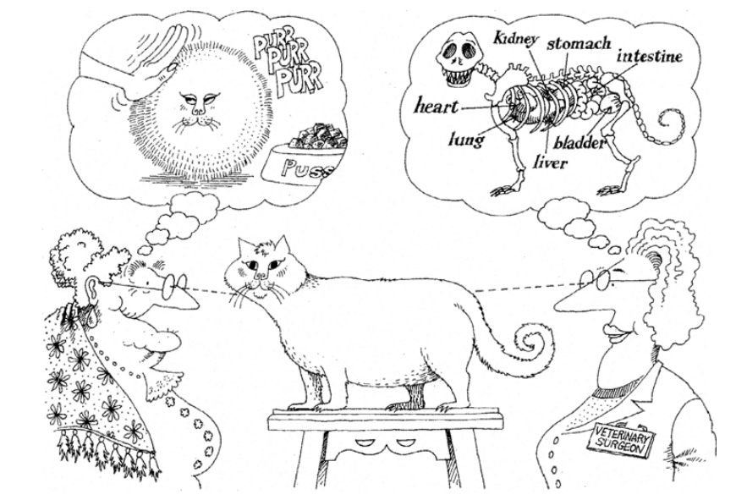
Abstraction

Slide 84
Invariant, pre- and post- conditions
An invariant is some Boolean (true or false) condition whose truth must be preserved
Pre-conditions (invariants assumed by the operation)
Post-conditions (invariants satisfied by the operation).
An exception is an indication that some invariant has not been or cannot be satisfied.

Slide 85
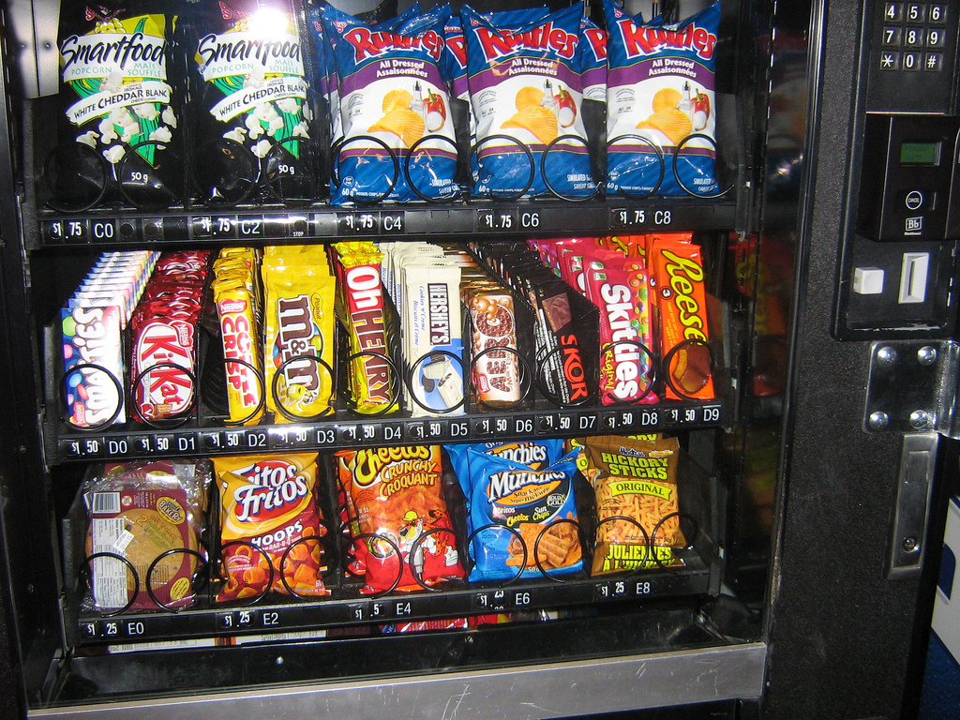
Case study-Vending Machine
Vending Machine that allows users to buy snack items. In addition, a user can find out the caloric content of her choice.

Slide 86
Specification
A Vending machine holds a number of snack items and displays the list of snack items and their prices through an user interface with a display screen and buttons for making selections. In addition, the vending machine has a receptacle for money and an item dispenser.
A user can make a selection and query for the number of calories of a snack item. The calories are displayed on pressing a button. A user can place the money in the receptacle and select an item.

Slide 87
Step 1
A Vending machine holds a number of snack items and displays the list of snack items and their prices through an user interface with a display screen and buttons for making selections. In addition, the vending machine has a receptacle for money and an item dispenser.
A user can make a selection and query for the number of calories of a snack item. The calories are displayed on pressing a button. A user can place the money in the receptacle and select an item.

Slide 88
Step 1
A Vending machine holds a number of snack items and displays the list of snack items and their prices through an user interface with a display screen and buttons for making selections. In addition, the vending machine has a receptacle for money and an item dispenser.
A user can make a selection and query for the number of calories of a snack item. The calories are displayed on pressing a button. A user can place the money in the receptacle and select an item.

Slide 89
Example-Vending Machine
Most of the nouns are objects/classes.
Some nouns are attributes of these classes.
The verbs are actions that can be attached to these objects.
In order to focus on the problem-domain objects, let us separate the object/classes into presentation-specific (user-interface related) and problem-specific classes.
Write the CRC cards for wo problem specific classes.

Slide 90
Example-Vending Machine
Problem-specific
Presentation-specific
Vending Machine
Snack item
Price
Calories
Selection
User
Display screen
Selection Buttons
Item Dispenser
Money receptacle

Slide 91
Thank you
Next Lecture: C++ Continues with Class Identification

